Slide 1
Forensic Analysis of Browsers
-Shrey Dhungana
- Syed Ali Qasim

Slide 2
Goal of the project
Forensic analysis of the browsing data of following browsers on Ubutnu, Windows 7 and Mac OSX.
Firefox, Google Chrome, Internet Explorer and Safari.
Analysis of the private browsing data on volatile memory and hard drive.
Retrieval of artifacts from the “private browsing” mode.
Retrieval of deleted normal browsing data.
Conclusion based on the privacy of browsers.

Slide 3
Contents
Part One : Forensic Analysis of deleted browsing. Privacy – Browser Fingerprinting -Shrey Dhungana | Pages : 5 -13 14-6
Part Two: Retrieval of Artifacts from Private Browsing. -Syed Ali Qasim | 17 -30
Conclusion and Related Work | 31-33

Slide 4
Introduction
Web browsers use the SQLite Database to store the browsing data.
This database structure has user history, passwords, searches, extensions, plugins, user preferences etc.
Forensic Analysis of this database gives the complete browsing data of a user.
Threat model – Local or Web Attacker.
We assume an attacker/forensic analyst accesses a machine after the user has left the machine.
Two scenarios : User can delete the browsing history or use the “private” or “ incognito mode”.
Retrieval of the artifacts for Firefox, Chrome, Edge browsing sessions.

Slide 5
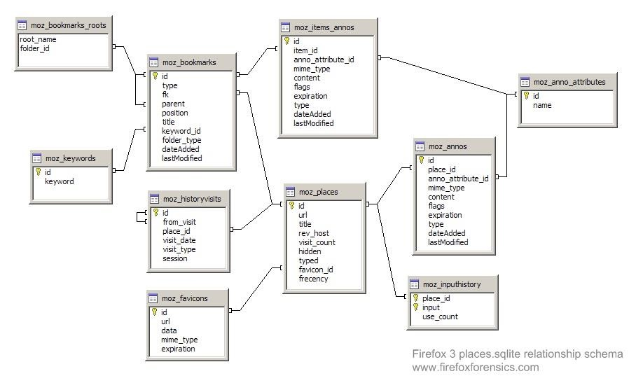
Firefox Database Structure

Slide 6
Implementation : Firefox
Files | Data Stored
places.sqlite | Bookmarks, history, download list
key3.db and logins.json | Password Manager, Saved Passwords
permissions.sqlite,content-prefs.sqlite | Site-specific preferences
search.json.mozlz4 | Search engines
persdict.dat | Personal dictionary
formhistory.sqlite | Autocomplete history
cookie.sqlite | Cookies
prefs.js | Customized changes
Cert8.db | Security Setting and SSL certificates
webappsstore.sqlite, chromeappsstore.sqlite | Dom Storage
secmod.db | Security device settings

Slide 7
Implementation : Firefox
We used OS, Ubuntu 16.04 and Windows 7 machines.
Firefox supports multiple user profiles.
Firefox(including 3 other browsers) do not update history file in private mode and delete other data on exit.
Not all data is deleted.
In MacOS Sierra, Firefox database is found ~/Library/ApplicationSupport/Firefox/Profiles/somename.default/places.sqlite
In Windows C:\Users\csadmin\AppData\Local\Temp\BCLTMP\firefox\places.sqlite
In Ubuntu : /home/<user>/.mozilla/firefox/<profile folder>/places.sqlite
62.0.3202.94

Slide 8
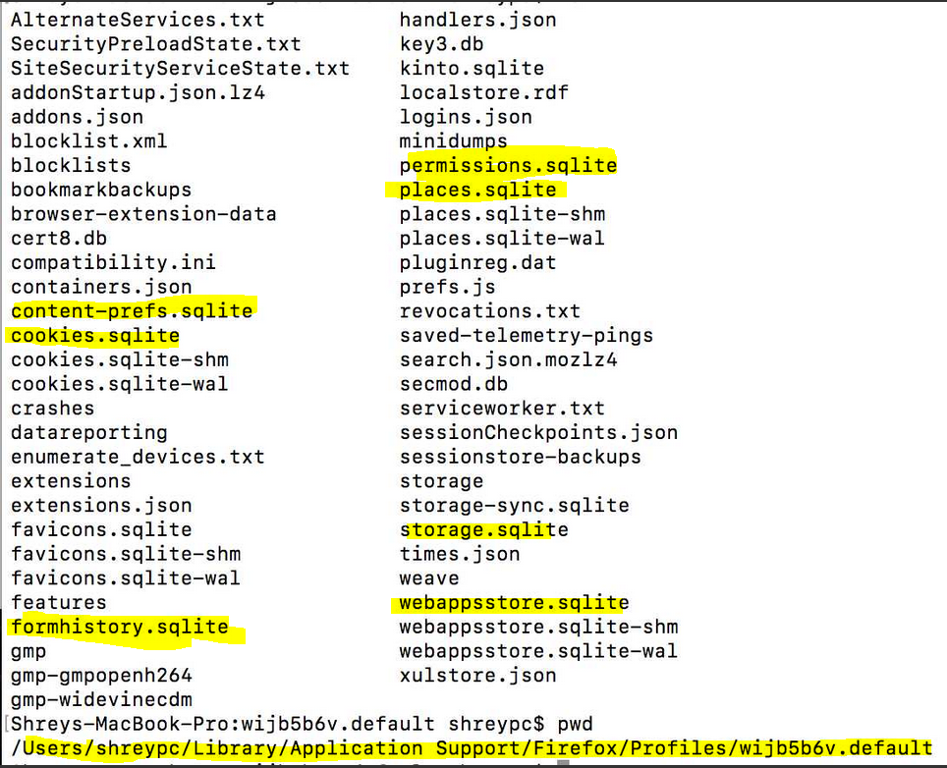
Implementation
We use SQLite DB Browser to analyze the browsing data.
In our test, we assume the local attacker gains the access after user deletes the history.
We use file recovery software Disk Drill in macOS and Recuva in Windows 10.
Attacker/Analyst can take the copy the database files.
In case web attackers get access, they can not view live sessions because of lock but can steal database files.

Slide 9
Implementation : Firefox
Step 1 : Delete all the history, cookies and all the data from the browsing session.
Step 2 : Run the photorec or disk drill recovery software.
Step 4 : Recovered the .sqlite files.
Step 5 : places.sqlite file is of interest.
Step 6 : Open the places.sqlite file in SQLite DB .
Step 7 : Able to search for searches, history, and browsing data.
Step 8 : Time in NSDate format , converted to accurate time
Notes:
Used it in Windows10 , MacOS Sierra and Ubuntu 16.04

Slide 10
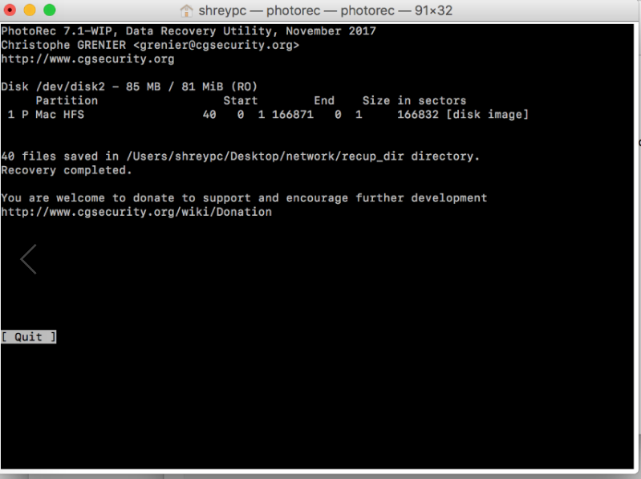
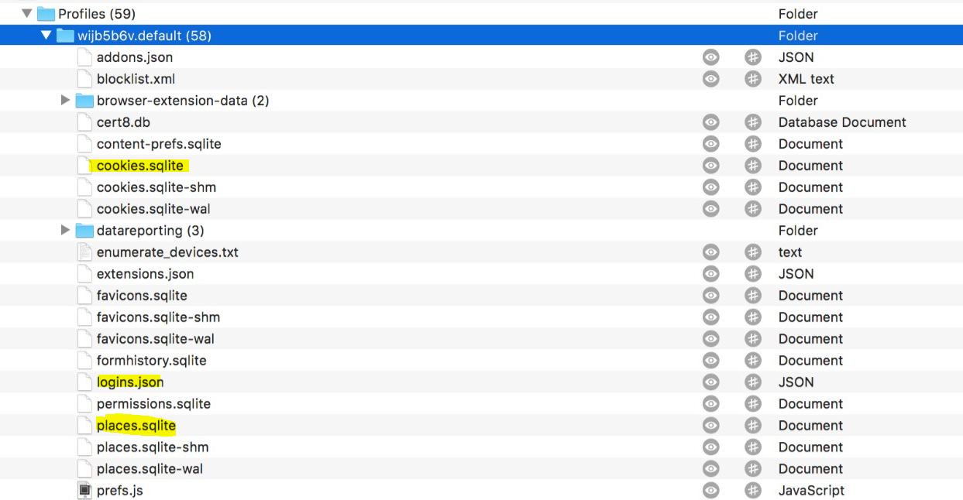
Firefox : Data Recovery
Notes:
Softwares : Photorec and Disk Drill for MacOS. Recuva for windows .

Slide 11
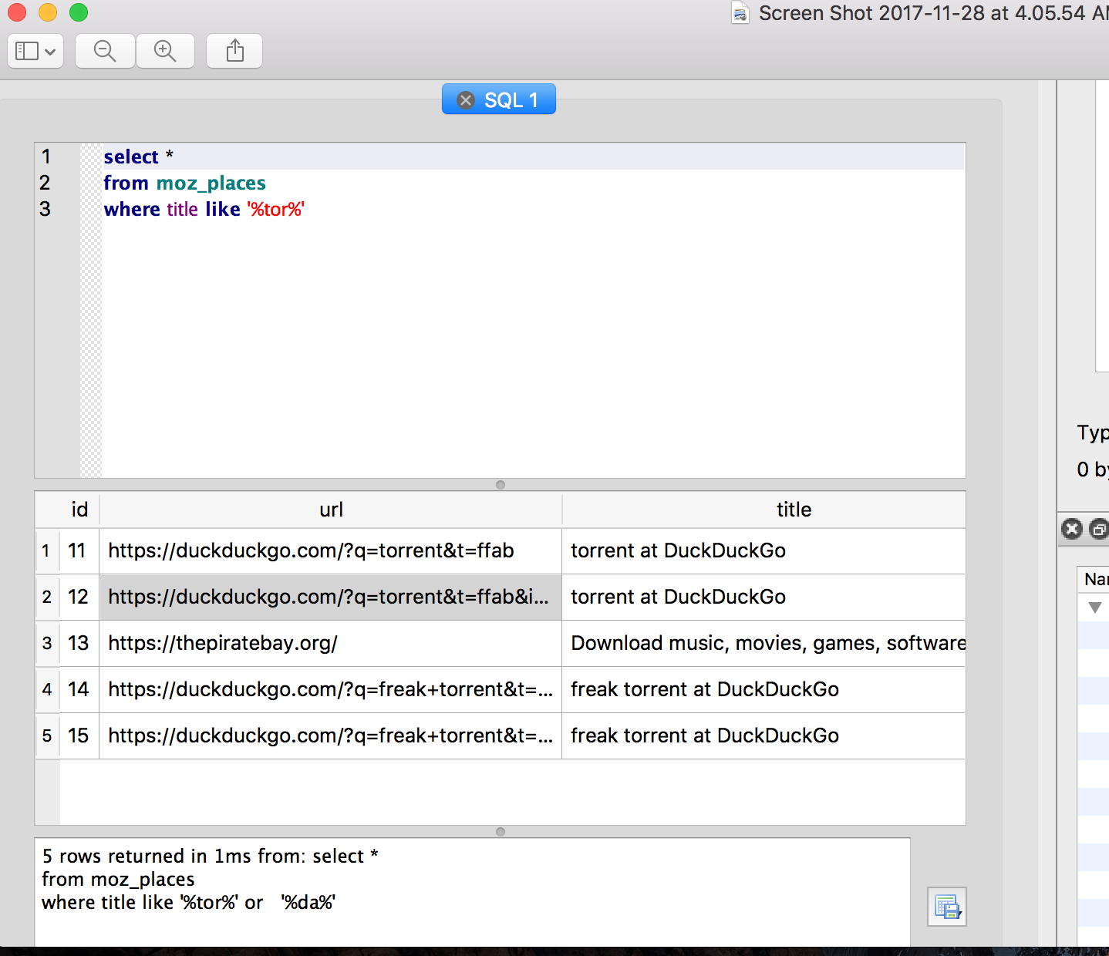
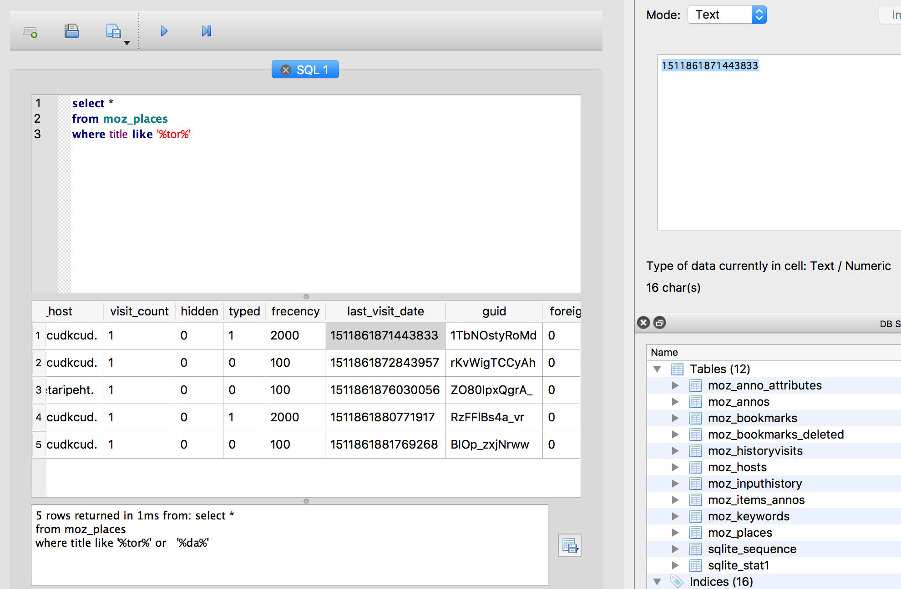
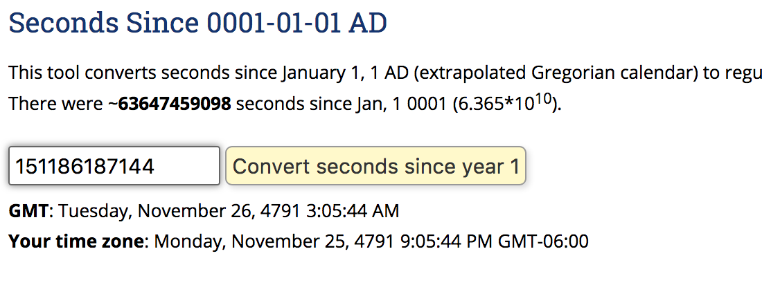
Firefox : Information Retrieval
Notes:
Able to retrieve the url searches, title searches, along with the time stamp.

Slide 12
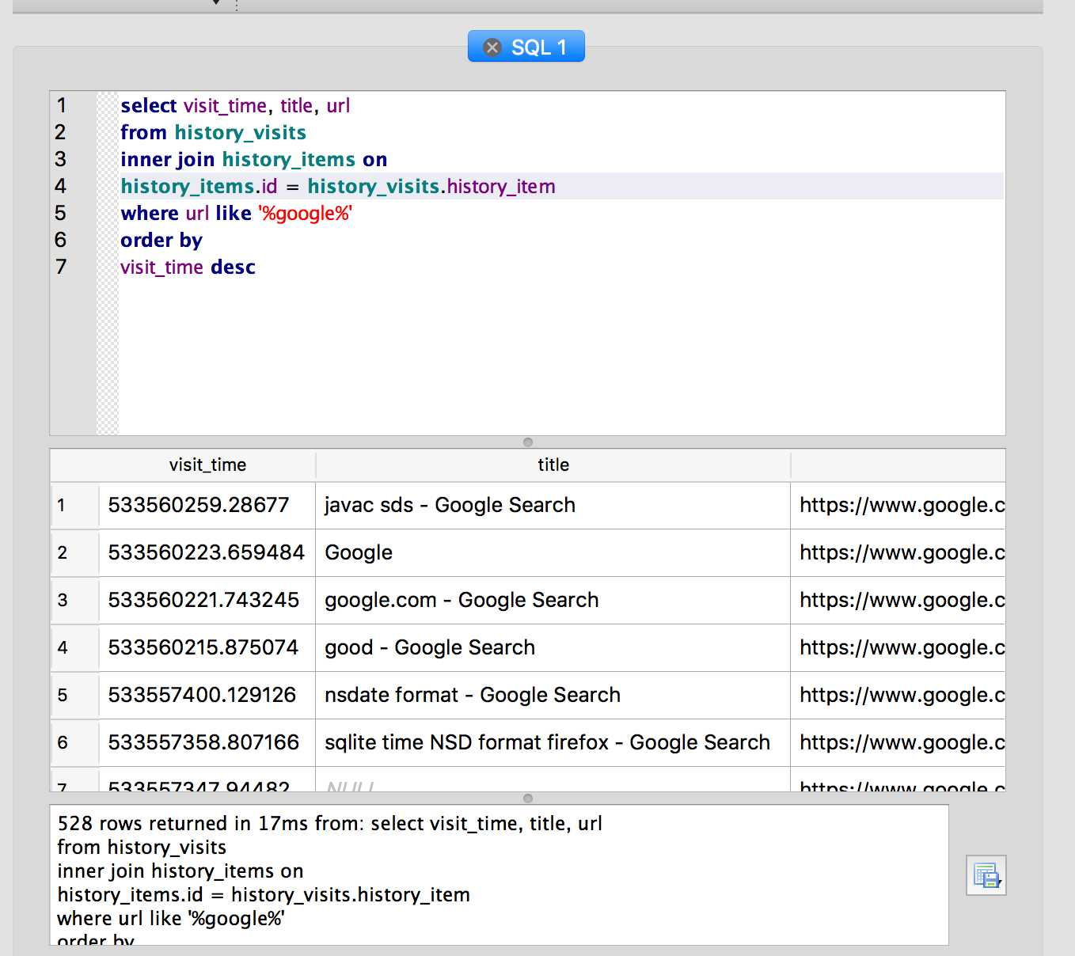
Safari : Browsing Data Retrieval
Followed the previous steps.
Using the appropriate queries
Browsing data with the time in descending order for google.com
Able to retrieve a user’s browsing data after history and cache deletion.

Slide 13
Findings
Firefox
Safari
Able to extract the deleted Firefox history in Ubuntu, Mac OS, and Windows 10.
Versions of Firefox used : 57.0, 56.02.
Complete browsing detail of a user with queries and time.
For private browsing memory capture was used.
Database found in : ~/Library/Safari/History.db
Deleted browsing data and applied recovery
Able to extract data with queries
Similar structure with different keys.
Private browsing does not save data to the disk.

Slide 14
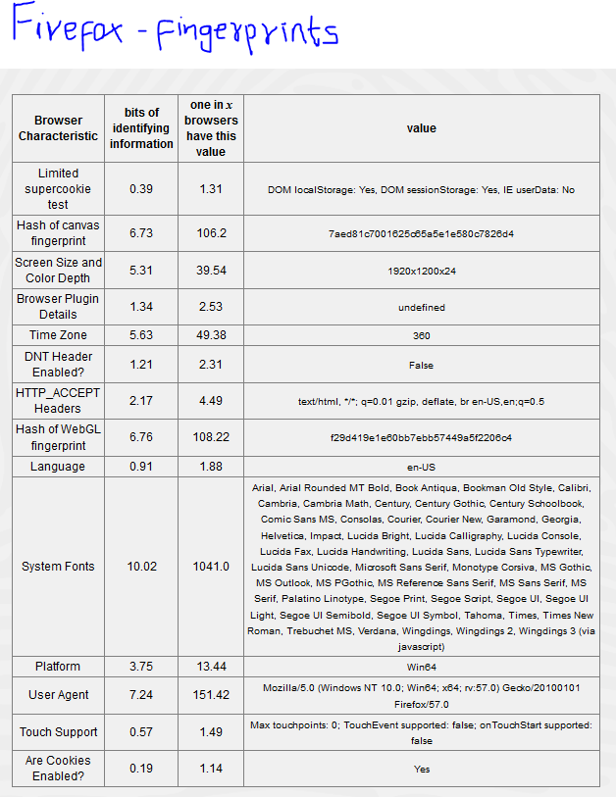
Browser Fingerprints
A website can link a user in normal mode to private mode based on
identifying bits of canvas fingerprint, plugins, HTTP_ACCEPT, System Fonts, Time Zone etc.
Browser Fingerprinting allows websites to passively gather data
Panopticlick study showed on around 1 million visits, 83.6 % browsers had unique fingerprint, for Flash and Java enabled, 94.2 %.
Cookies not needed.

Slide 15
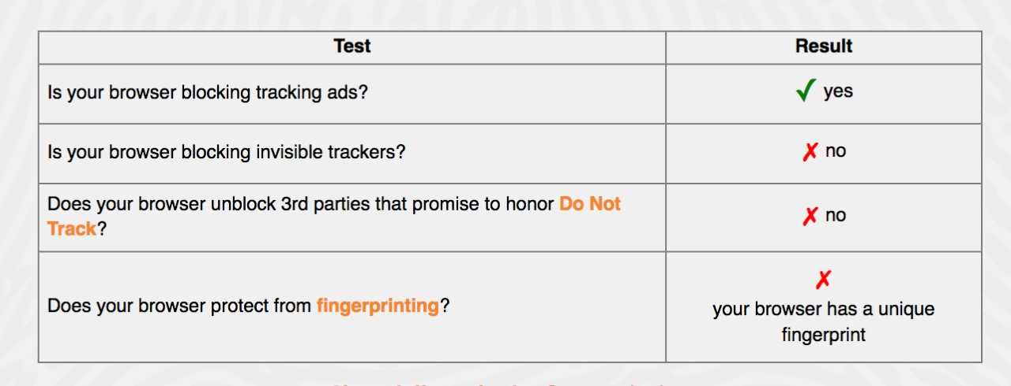
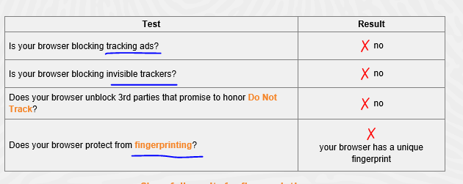
Fingerprint Comparison
Microsoft Edge 40.15063.674.0
Safari 11.01
Notes:
All browsers are prone to the fingerprinting Firefox and Safari block tracking ads

Slide 16
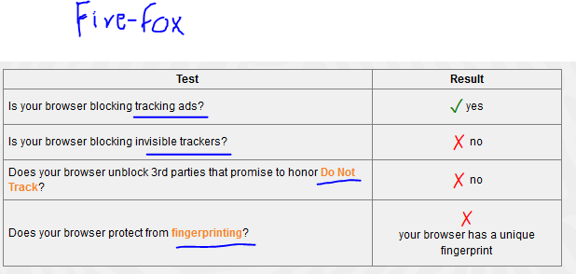
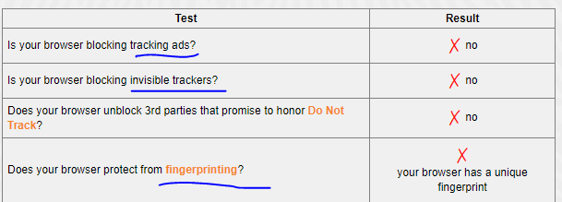
Fingerprint Comparison
Chrome 62.0.3202.94
Firefox 57.0
http://2016.padjo.org/tutorials/sqlite-your-browser-history/

Slide 17
Part Two : Forensic analysis of private browsing mode
Microsoft Edge V(25.10586.672.0)
Google Chrome V(62.0.3202.94)
Mozilla Firefox v(57.0)
Tools Used:
FDK imager
Whatchanged.exe
Volatility
Strings
Recuva
WinHex
System:
Windows 7
2 GB RAM 60 GB storage

Slide 18
Experiment:
For each web browser:
Opened the private browsing and visited the following website:
www.mirror.co.uk
www.uno.edu
www.livescore.com
Searched for the following terms on google:
Black Friday
Football
Winter
Logged into privateer place resident portal
https://portal.campushousing.com/UNO-Privateer-Place/Default.aspx?Params=L9ezxPcQnQuRGKTzF%2b4sxeNblvAA%2b26c&_ga=2.189002987.1937925296.1511825121-710119258.1511825121

Slide 19
Stopped the private browsing and captured the RAM and pagefile using FTK Imager
Used whatchanged.exe to find the changes made in the filesystem by private browsing
Tried to recover any deleted data.
Analyzed the RAM using volatility and strings to find network connections, html code, usernames, passwords, images etc. related to private browsing

Slide 20
Microsoft Edge
According to Microsoft:
“When you use InPrivate tabs or windows, your browsing data (like your history, temporary internet files, and cookies) isn't saved on your PC once you're done.”
Findings:
Unlike other browsers edge stores the private browsing data on filesystem and deletes it after the session.
Using whatchanged.exe I found the changed made on file system and recovered the deleted files

Slide 21
Edge store the files in C:\Users\(username)\AppData\Local\Packages\Microsoft.MicrosoftEdge_(profile) \AC\#!001\MicrosoftEdge\Cache C:\Users\(username)\AppData\Local\Packages\Microsoft.MicrosoftEdge_(profile) \AC\#!002\MicrosoftEdge\Cache In my case: C:\Users\test\AppData\Local\Packages\Microsoft.MicrosoftEdge_8wekyb3d8bbwe\AC\#!001\MicrosoftEdge\Cache C:\Users\test\AppData\Local\Packages\Microsoft.MicrosoftEdge_8wekyb3d8bbwe\AC\#!002\MicrosoftEdge\Cache
Recuva recovered around 700 files including html,JavaScript and images.

Slide 22
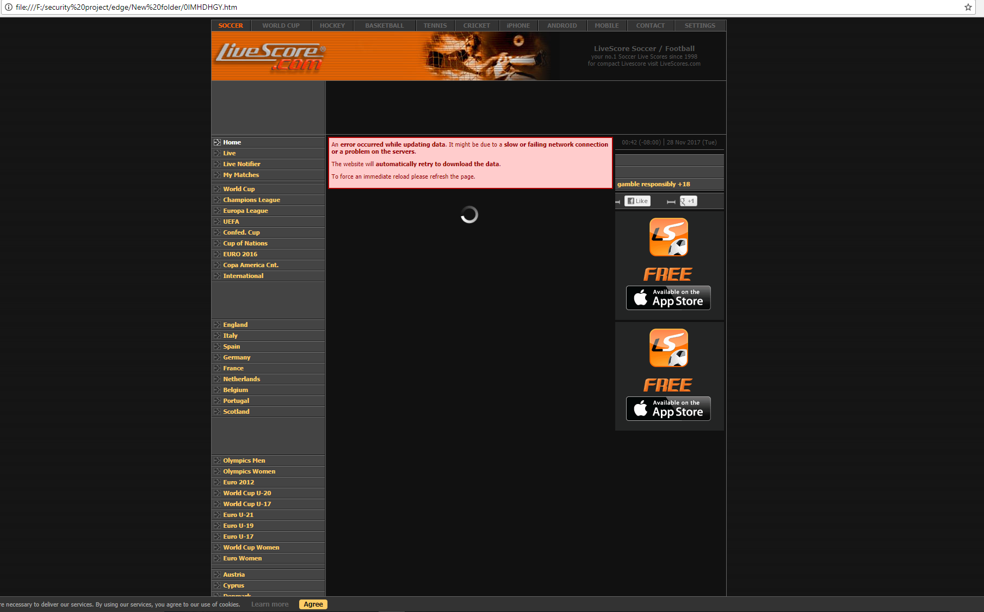

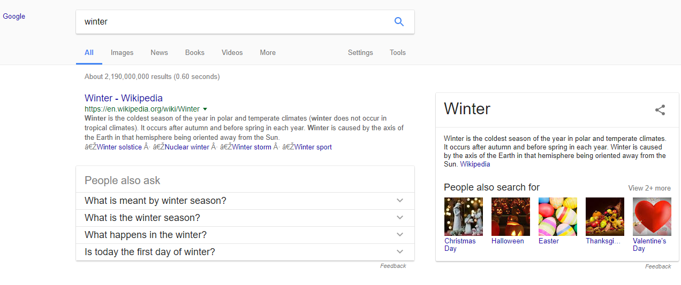

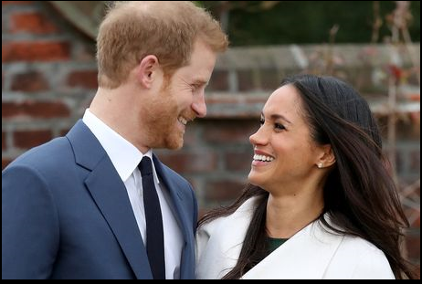

Some of the recovered artifacts:

Slide 23
RAM
I was unable to find connection between the host and visited websites. Most of the ips found during ram analysis were related to akami, amazon and other third party servers and content distributors. But the strings analysis of RAM showed the get request to all the websites visited during private session

Slide 24
Google Chrome: “Chrome doesn't save your browsing history or information entered in forms. Cookies and site data are remembered while you're browsing, but deleted when you close Incognito mode.”
When you use incognito window google Chorme store the data on RAM.
Findings:
There was some changes in the file system in
C:\Users\test\AppData\Local\Google\Chrome\User Data\Default\
But my recovery software was unable to recover those files

Slide 25
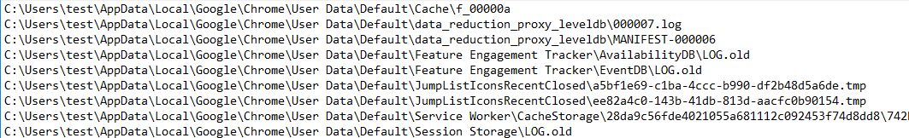
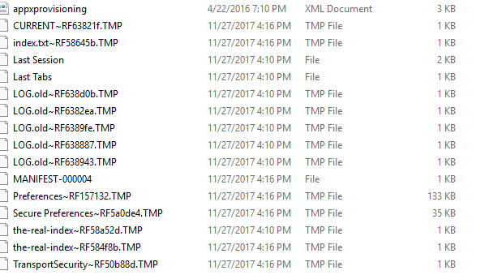

Slide 26
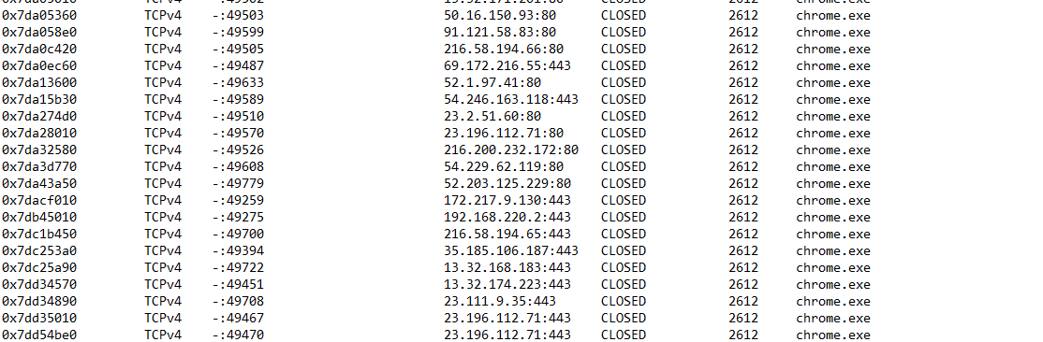
RAM
My goal was to find the network connections made by the host and figure out the webpages visited. So I used volatility to analyze the network information. So I used netscan commands to scan for tcp connections.

Slide 27
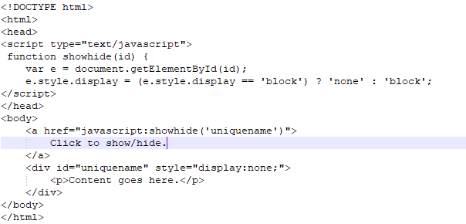
But almost all the connections found were to third party servers and content provides like akami.
There was one tcp connection with www.google.com 216.58.194.65:80
Then I used strings tool to find the readable strings present in the ram and was able to see the http request made to websites in experiment.
I also found large amount of html code which can be used to reconstruct the webpages.

Slide 28
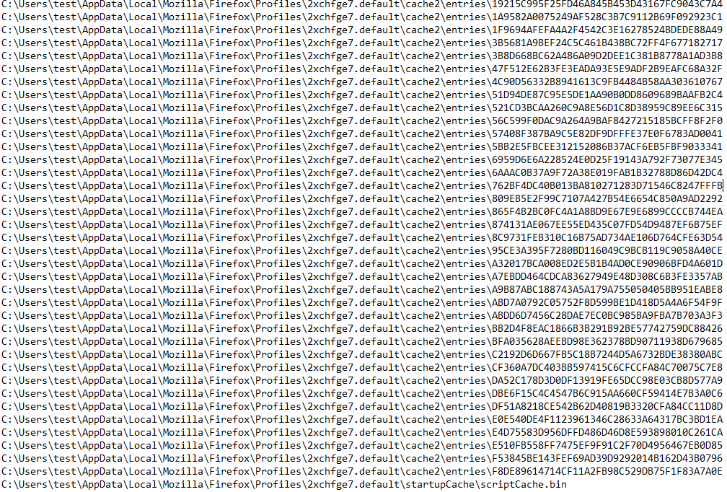
Mozilla Firefox
Similar to chrome, Firefox also don’t save visited pages, cookies, searches and temporary files during the private browsing and most of the data is stored on RAM.
Findings:
The whatchanged.exe showed that filesystem was changed after the private browsing session and some files in the cache2\entries were deleted after the session and I am unable to recover these.

Slide 29
RAM:
The RAM analysis of Firefox were similar to chrome and edge and most of the tcp connection were to third party servers and content provides.
String results showed the get requests to websites and html code.

Slide 30
A separate experiment was run to test the known DNS caching threat.
The vulnerability is caused due to the operating system caching all the DNS queries sent by a web browser. We confirm that this vulnerability still persist in latest versions of all browsers. The queries made during the private sessions are also not removed/deleted and anyone on the system can see this.

Slide 31
Conclusions
Deleting Browsing history does not remove the track of web browsing.
Private Browsing does not save the data to the hard drive but memory analysis can help to retrieve it.
In Microsoft Edge private browsing data is saved to hard drive and deleted it. So, retrieval is possible.
DNS cache after private browsing is still visible in all four major browsers.
A website can track a user using browser fingerprinting which can not be prevented by private browsing.
Tor browser or Tor extension for Firefox are examples that provide relatively anonymous browsing.

Slide 32
Related Works:
1. Aggarwal, Gaurav, Elie Bursztein, Collin Jackson, and Dan Boneh. An Analysis of Private Browsing Modes in Modern Browsers." Proceedings of the 19th USENIX Security Symposium, Wardman Park Marriott Hotel, Washington, D.C. 11-13 Aug. 2013. Web. 8
2. In Private Browsing." Microsoft Windows. Microsoft, 10 Dec. 2013. Web. 10 Dec. 2013. <http://windows.microsoft.com/en-us/internet-explorer/products/ie-9/features/in-private>.
3. Ohana, Donny, and Narasimha Shashidhar. “Do Private and Portable Web Browsers Leave Incriminating Evidence? A Forensic Analysis of Residual Artifacts from Private and PortableWeb Browsing Sessions." IEEE CS Security and Privacy Workshops (SPW),The Westin St. Francis, San Francisco, CA. 23-24 May 2013. Web. 9 Dec. 2013.
4. Said, Huwida, Noora Al Mutawa, Ibtesam Al Awadhi, and Mario Guimaraes. “Forensic Analysis of Private Browsing Artifacts." 7th International Conference on Innovations in Information Technology, Abu Dhabi, United Arab Emirates. 25-27 Apr. 2011.
5. Verdi, Michael et al.Private Browsing." Mozilla Support. Mozilla Foundation, 29 Mar. 2013. Web. 10 Dec. 2013.

Slide 33
Related work:
What Private Browsing Leaves Behind John Filleau, Milda Zizyte Electrical and Computer Engineering, Carnegie Mellon University Pittsburgh, Pennsylvania, USA jfilleau@cmu.edu milda@cmu.edu
On the Privacy of Private Browsing – A Forensic Approach Kiavash Satvat, Matthew Forshaw, Feng Hao, Ehsan Toreini School of Computing Science Newcastle University
Forensic Analysis of Private Browsing Artifacts Huwida Said, Noora Al Mutawa, Ibtesam Al Awadhi and Mario Guimaraes College of Information Technology Zayed University, Dubai United Arab Emirates {Huwida.said, M80000952, M80000938, Mario.guimaraes}@zu.ac.ae

